Slide 1
Parallel and Distributed Databases
Prof. Saed SAYAd

Slide 2
Why Parallel and Distributed Databases?
Data is too large, too big and too many (Big Data)
In a centralized database:
Data is located in one place (one server) and all DBMS functionalities are done by that server
Enforcing ACID properties of transactions, taking care of concurrency control, recovery mechanisms and answering queries
Applications are by nature distributed
A bank with many branches or a chain of retail stores with many locations
There is a need for parallel and distributed processing
Divide a big problem into many smaller ones to be solved in parallel
Increase bandwidth (e.g., Faster response time for queries)

Slide 3
Parallel and Distributed Databases
Sharing data is the key of a distributed DB (cooperative approach)
Since data is distributed, users that share that data can have it placed at the site they work on, with local control (local autonomy)
Distributed and parallel databases improve reliability and availability
They have replicated components and thus eliminate single points of failure
The distribution of data and the parallel/distributed processing is not visible to the users (transparency)
A parallel database aims principally linear speedup and linear scaleup
If there is an average 1 percent slowdown per additional CPU means a system with 1000 CPU is only 4 percent as effective as a single CPU system!

Slide 4
Parallel Database System
Seeks to improve performance through parallelization of various operations, such as: loading data, building indices, valuating queries and more
Although data may be stored in a distributed fashion in such a system, the distribution is governed solely by performance considerations.
Machines are physically close to each other, e.g., same server room
Machines connects with dedicated high-speed LANs and switches
Communication cost is assumed to be small
A parallel database aims principally linear speedup and linear scaleup
Linear speedup means the time taken for operations decreases linearly in proportion to the increase in the numbers of CPUs and disks
Linear scaleup means performance is sustained if the number of CPUs and disks are increased in proportion to the amount of data

Slide 5
Architectures for Parallel Databases
Interconnection Network
P
P
P
P
P
P
P
P
P
Interconnection Network
M
M
M
M
M
M
M
M
M
Interconnection Network
D
D
D
D
D
D
D
D
D
SHARED NOTHING
SHARED MEMORY
SHARED DISK

Slide 6
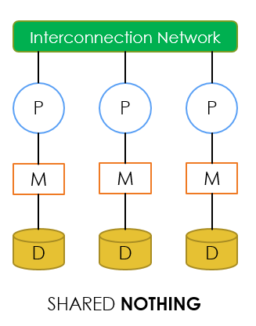
SHARED NOTHING
In a shared-nothing parallel system, each CPU has local main memory and disk space, but no two CPUs can access the same storage area.
All communication between CPUs is through a network connection.

Slide 7
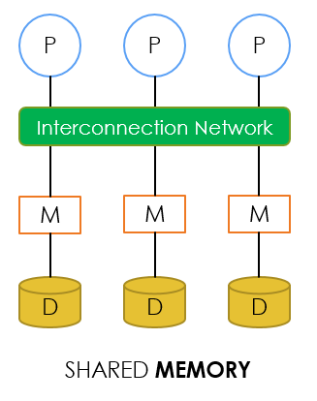
SHARED MEMORY
In a shared-memory parallel system, multiple CPUs are attached to an interconnection network and can access a common region of main memory.
Every processor has its own disk
Single memory address-space for all processors
Reading or writing to far memory can be slightly more expensive
Every processor can have its own local memory and cache as well

Slide 8
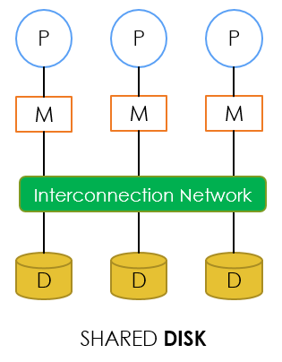
SHARED DISK
In a shared-disk system, each CPU has a private memory and direct access to all disks through an interconnection network.
Every processor has its own memory (not accessible by others)
All machines can access all disks in the system
Number of disks does not necessarily match the number of processors

Slide 9
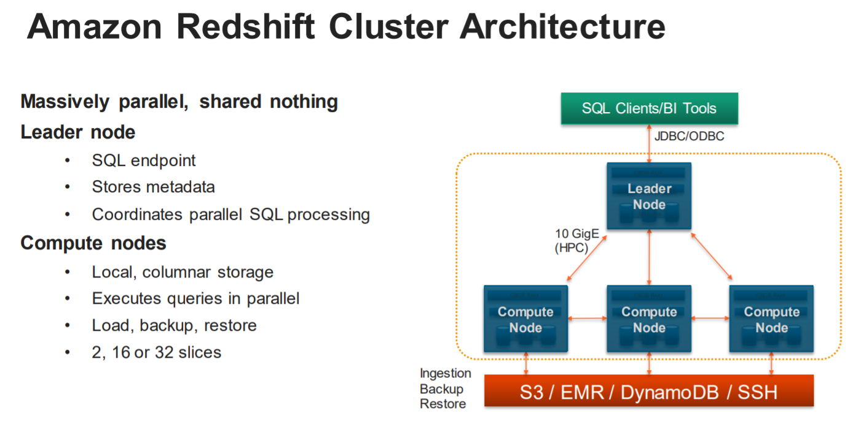

Slide 10
Types of parallelism in database systems
Interquery parallelism: Parallelism between queries. Multiple queries generated by concurrent transactions can be executed in parallel
Intraquery parallelism : Parallelism within a query
Interoperation parallelism: A query may consist of multiple, independent operations that can be executed in parallel. There are two forms of interoperation parallelism:
Independent: Operations in a query that do not depend on one another are executed in parallel. It does not provide a high degree of parallelism
Pipeline : The output of operation A is consumed by another operation B, before A has produced the entire output Many machines, each doing one step in a multi-step process
Intraoperation parallelism: An operator may be executed as many small, independent sub-operations. The relational model is ideal for implementing intraoperation parallelism

Slide 11
Distributed Databases
A collection of multiple, logically interrelated databases distributed over a computer network with the following features:
Improved reliability and availability through distributed transactions
Improved performance
Allowing data sharing while maintaining some measure of local control
Easier and more economical system expansion
Distributed Database Management System (D-DBMS) is a software system that permits the management of the DDB and provides an access mechanism that makes this distribution transparent to the users

Slide 12
Distributed Databases - Functionalities
To access remote sites and transmit queries and data among the various sites via a communication network
To keep track of the data distribution and replication in the DDBMS catalog
To devise execution strategies for queries and transactions that access data from more than one site
To decide on which copy of a replicated data item to access
To maintain the consistency of copies of a replicated data item
To maintain the global conceptual schema of the distributed database
To recover from individual site crashes and from new types of failures such as failure of a communication link

Slide 13
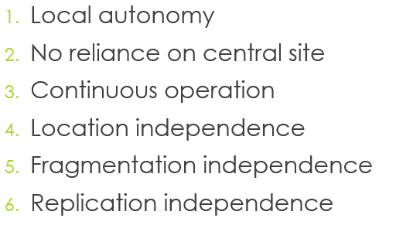
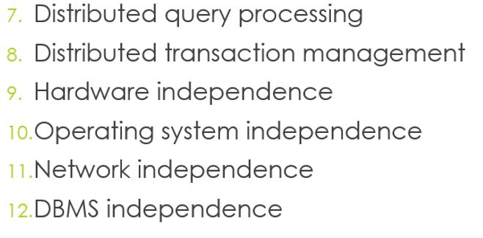
Distributed Databases – Date’s 12 Rules
Rule 0: to the user, a distributed system should look exactly like a non-distributed system
Autonomy, Independence and Transparency

Slide 14
Rule 1: Local Autonomy
Sites should be autonomous to the maximum extent possible
Local data is locally owned and managed, with local accountability
security considerations
integrity considerations
All operations at a given site are controlled by that site locally; no site X should depend on some other site Y for its successful functioning. Otherwise, if site Y is down, site X could not carry out the operation although there is nothing wrong at site X
In some situations some slight loss of autonomy is inevitable
Local databases own their data even it is accessible from remote

Slide 15
Rule 2: No reliance on central site
There must not be any reliance on a central ‘master’ site for some central service, such as centralized query processing or centralized transaction management, such that the entire system is dependent on that central site, because:
that central site might be a bottleneck
the system would be vulnerable to a specific site vulenrability
In a distributed system therefore, the following tasks (among others) must all be distributed:
Dictionary management
Query processing
Concurrency control
Recovery control

Slide 16
Rule 3: Continuous operation
There should ideally never be a need for a planned entire system shutdown
Incorporating a new site into an existing distributed system should not bring the entire system to a halt or should not require any changes to existing user programs or terminal activities
Removing an existing site from the distributed systems should not cause any unnecessary interruptions in service
Within the distributed system, it should be possible to create and destroy fragments and replicas of fragments dynamically
It should be possible to upgrade the DBMS at any given component site to a newer release without taking the entire system down

Slide 17
Rule 4: Location Independence
Users should not have to know where data is physically stored (location transparency)
Simplifies user programs and terminal activities
Allows data to migrate from site to site
It is easier to provide location independence for simple retrieval operations than it is for update operations
Distributed data naming scheme and corresponding support from the dictionary subsystem
User naming scheme
An user has to have a valid logon ID at each of multiple sites to operate
User profile for each valid logon ID in the dictionary
Granting of access privileges at each component site

Slide 18
Rule 5: Fragmentation Independence
A distributed system supports data fragmentation if a given relation can be divided up into pieces or ‘fragments’ for physical storage purposes
A system that supports data fragmentation should also support fragmentation independence or transparency
Users should be able to behave (at least from a logical standpoint) as if the data were in fact not fragmented at all
Fragmentation is desirable for performance reasons
Fragmentation independence (like location independence) is desirable because it simplifies user programs and terminal activities
Fragmentation transparency implies that users should normally be presented with a view of the data in which the fragments are logically combined together by means of suitable joins and unions

Slide 19
Two basic kinds of Fragmentation
Horizontal fragmentation
refers to cut between tuples
achieved by selection
same as data partitioning in parallel databases
efficient for parallel scanning of the relation
Vertical fragmentation
refers to the cut of the schema
achieved by a projection
efficient if there is frequent access to different attribute groups
The union of the horizontal fragments should be the original relation
The join of the vertical fragments should be the original relation

Slide 20
Rule 6: Replication Independence
User should be able to behave as if the data were in fact not replicated at all (Replication Independence or Transparency)
A distributed system supports data replication if a given relation (more generally, a given fragments of a relation) can be represented at the physical level by many distinct stored copies or replicas, at many distinct sites
Replication is desirable for at least two reasons:
Performance: applications can operate on local copies instead of having communicate with remote sites
Availability: a given replicated object remains available for processing as long as at least one copy remains available
Fragmentation transparency (like all transparency rules) is desirable because it simplifies user programs and terminal activities
The major disadvantage of replication is when a given replicated object is updated, all copies of that object must be updated

Slide 21
Rule 7: Distributed query processing
Amount of data communication is a major performance factor. It is crucially important for distributed database systems to choose a good strategy for distributed query processing
Query processing in a distributed system involve
local CPU and I/O activity at several distinct sites
some amount of data communication among those sites
Depending on the bandwidth and the relation sizes the minimal communication cost strategy will be chosen
Distributed query processing and query optimization must be aware of the distributed context:
Where is a relation (fragment) stored?
Are there any replicas?
Views that span multiple sites
Integrity constraints within a D-DBMS that span multiple sites

Slide 22
Rule 8: Distributed transaction management
Two major aspects of transaction management, recovery control and concurrency control, require extended treatment in the distributed environment
In a distributed system, a single transaction can involve the execution of code at multiple sites and can thus involve updates at multiple sites
Each transaction is therefore said to consist of multiple agents, where an agent is the process performed on behalf of a given transaction at a given site
Recovery Control: In order to ensure that a given transaction is atomic in the distributed environment, therefore, the system must ensure that the set of agents for that transaction either all commit in unison or all roll back in unison. That effect can be achieved by means of the two-phase commit protocol
Concurrency Control: is based in most distributed systems on locking

Slide 23
Recovery control: Two-phase commit protocol
FIRST PHASE: Each site must force-write all log entries for local resources used by the transaction out to its physical log. Assuming the force-write is successful, each site gives the OK.
SECOND PHASE: If the site where the transaction has been submitted receives all the OK form the other sites, it force-writes an entry to its own physical log. If anything has gone BAD, then general ROLLBACK otherwise the decision is COMMIT.

Slide 24
Rules 9-11: Hardware, OS and Network Independence
User should be presented with the “single-system image” regardless any particular hardware platform, operating system and network
It is desirable to be able to run the same DBMS on different hardware systems which all participate as equal partners (where appropriate) in a distributed system
If data is distributed but all servers run the same DBMS software, we have a homogenous distributed database system otherwise heterogenous distributed database system also referred as multidatabase system.
A distributed database system needs a reliable message transmission service
The network should also be responsible for site authentication

Slide 25
Rule 12: DBMS independence
Ideal distributed system should provide DBMS independence (DBMS transparency)
All that is really needed is that the DBMS instances at different sites all support the same interface
Consider an example: Suppose that site X is running DB2 and site Y is running ORACLE. Some user at site X desires to see a single distributed database that includes data from DB2 (site X) and ORACLE from site Y. By definition user U is a an DB2 user and the distributed database must therefore be an DB2 database. The solution is quite straightforward: DB2 must provide an application program (gateway) that runs upon ORACLE and has the effect of 'making ORACLE look like DB2’
Implementing protocols for the exchange of information between DB2 and ORACLE involves first the understanding of the messages in which SQL sources are sent form DB2 and translated to ORACLE statements and mapping ORACLE results (data values, return codes, ...) into the messages format that DB2 expects

Slide 26
References
http://mazsola.iit.uni-miskolc.hu/tempus/discom/doc/db/tema01a.pdf
https://www2.cs.duke.edu/courses/fall17/cps216/Lectures/Lecture-20-Parallel-DB.pdf

